Slide 1

Customer Shopping Behavior Analysis
Analyzing transactional data from 3,900 purchases to uncover key insights into spending patterns, preferences, and subscription behavior.

Slide 2

Project Overview
Goal
Data Source
Objective
Optimize operations, reduce costs, and improve forecasting.
3,900 customer purchases across diverse product categories.
Guide strategic business decisions through data-driven insights.

Slide 3

Dataset Summary
Key Features
Data Volume
Customer demographics (Age, Gender, Location, Subscription)
3,900 Rows, 18 Columns
Missing Data
Purchase details (Item, Category, Amount, Season, Size, Color)
37 values in "Review Rating" column
Shopping behavior (Discount, Promo Code, Previous Purchases, Frequency, Review, Shipping)

Slide 4
Exploratory Data Analysis (Python)
01
02
03
Data Loading & Initial Exploration
Missing Data Handling
Column Standardization
Imputed "Review Rating" using median per product category.
Renamed columns to snake_case for readability.
Pandas import, df.info(), .describe() for structure and summary.
04
05
Feature Engineering
Database Integration
Created 'age_group' and 'purchase_frequency_days'.
Loaded cleaned DataFrame into PostgreSQL for SQL analysis.

Slide 5
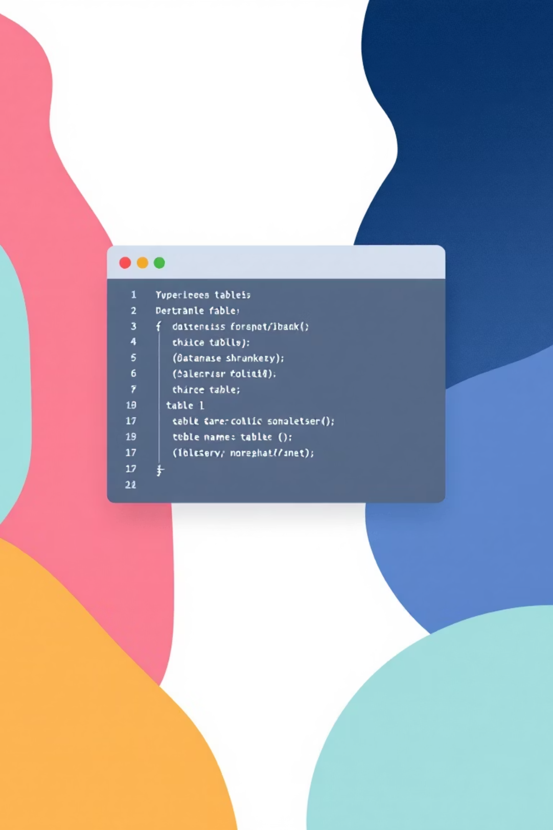

Data Analysis (SQL)
Revenue by Gender
Male: $157,890, Female: $75,191
Top 5 Products by Rating
Gloves (3.86), Sandals (3.84), Boots (3.82)
Shipping Type Comparison
Standard: $58.46, Express: $60.48

Slide 6

SQL Insights: Customer Behavior
1
2
3
Subscribers vs. Non-Subscribers
Discount-Dependent Products
Customer Segmentation
Loyal (3116), Returning (701), New (83)
Subscribers: 1053 customers, Avg Spend: $59.49
Hat (50%), Sneakers (49.66%), Coat (49.07%)

Slide 7

SQL Insights: Product & Loyalty
Top 3 Products per Category
Repeat Buyers & Subscriptions
Accessories: Jewelry, Sunglasses, Belt
958 repeat buyers are subscribers, 2518 are not.
Clothing: Blouse, Pants, Shirt
Revenue by Age Group
Footwear: Sandals, Shoes, Sneakers
Young Adult: $62,143, Middle-aged: $59,197

Slide 8
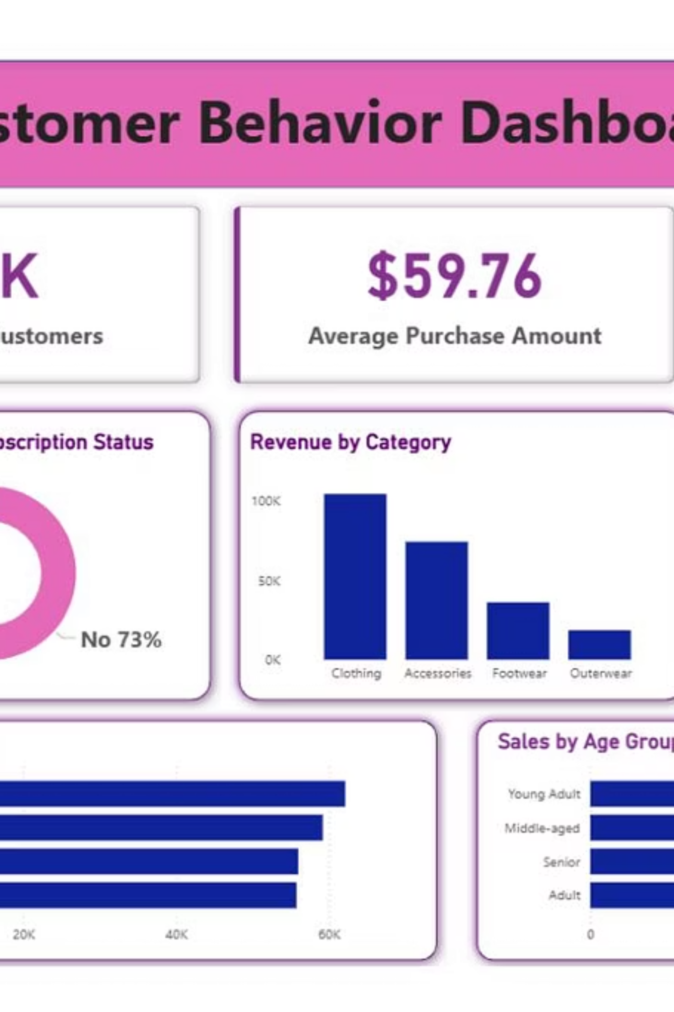
Power BI Dashboard
Interactive dashboard built to visually present key insights.

Slide 9

Business Recommendations
Boost Subscriptions
Customer Loyalty Programs
Review Discount Policy
Promote exclusive benefits for subscribers.
Reward repeat buyers to foster loyalty.
Balance sales boosts with margin control.

Slide 10
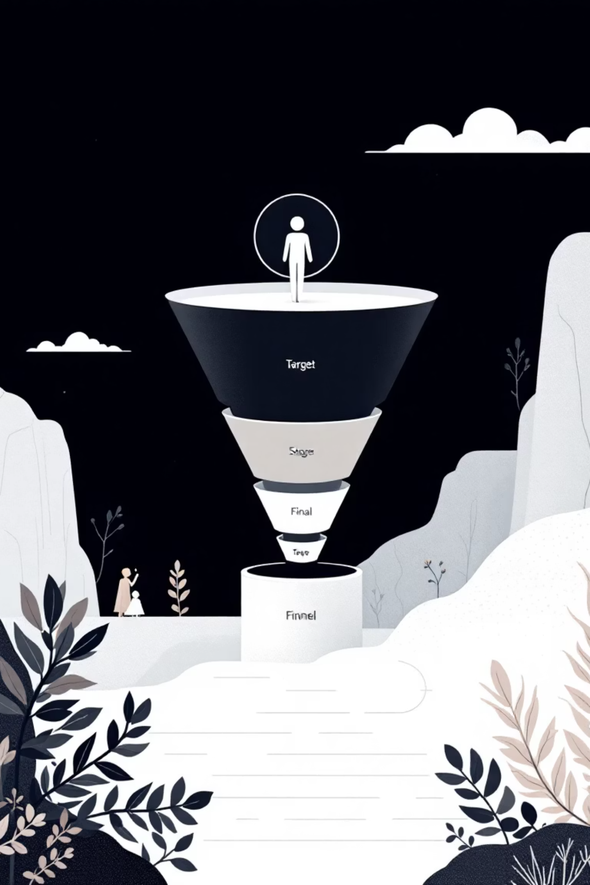
Strategic Product & Marketing
Product Positioning
Highlight top-rated and best-selling products in campaigns.
Targeted Marketing
Focus efforts on high-revenue age groups and express-shipping users.

